Slide 1
Bdd climate control project update
Connected Vehicle Analytics – GDIA
Aman Chopra
Mahtab Fard
07/15/2020

Slide 2
Key Points From Last Meeting
When analyzing F-150s, we should create two variable parameters, x and y, that allow us to include positive temperatures below x for y seconds within a subzero interval. Currently, subzero intervals include only negative temperatures, despite the fact that the temperature could become positive for 1 second and then drop below 0 again.
Our analysis should include statistics on how far below 0°C the temperature drops in each subzero interval. For example, an interval with temperatures reaching -5° C is more concerning than -0.25°C.
We should include recirculation signals.
* All temperatures being analyzed are in °C.

Slide 3
Progress
We have pulled data spanning the summer months (May – July) for 1 2019 F-150, which we are currently analyzing. In the coming week, we hope to scale this analysis to more F-150s for further insights.
Perform rudimentary analysis on Explorer.
Identify selection criteria for F-150s.
Determine CAN signals of interest.
Collect data for F-150s.
Conduct analysis.
Scale study to other vehicle types.

Slide 4
Data Loading & Preprocessing
High frequency data pulled from BDD for 2019 F-150 spanning months 05/19 – 07/19.
Trips defined by an interval where the difference between epoch is < 1800 (30 minutes).
Trips lasting less than 60 seconds or more than 12 hours filtered out.
Data filtered to only keep intervals where AC is on.

Slide 5
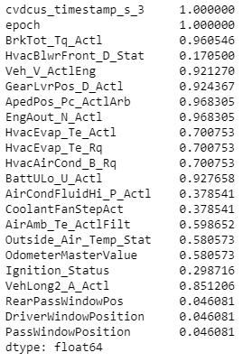
Data Loading & Preprocessing
Quality:
Missing values imputed using a combination of forward-filling for features with at least 50% non-null values and KNN for remaining features.

Slide 6
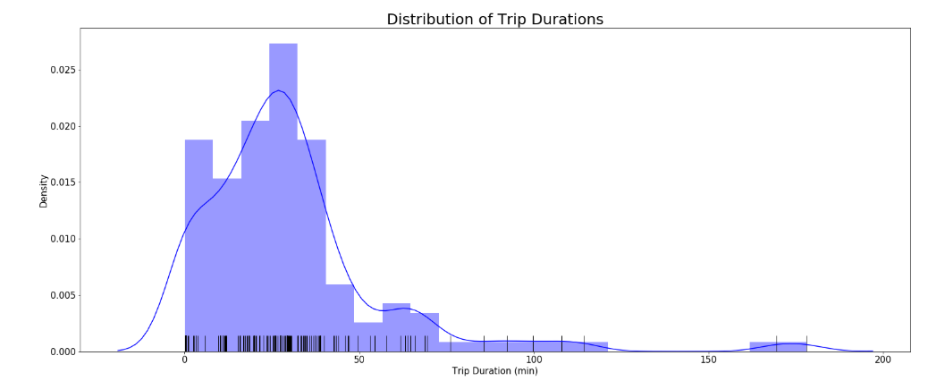
High-Level Statistics

Slide 7
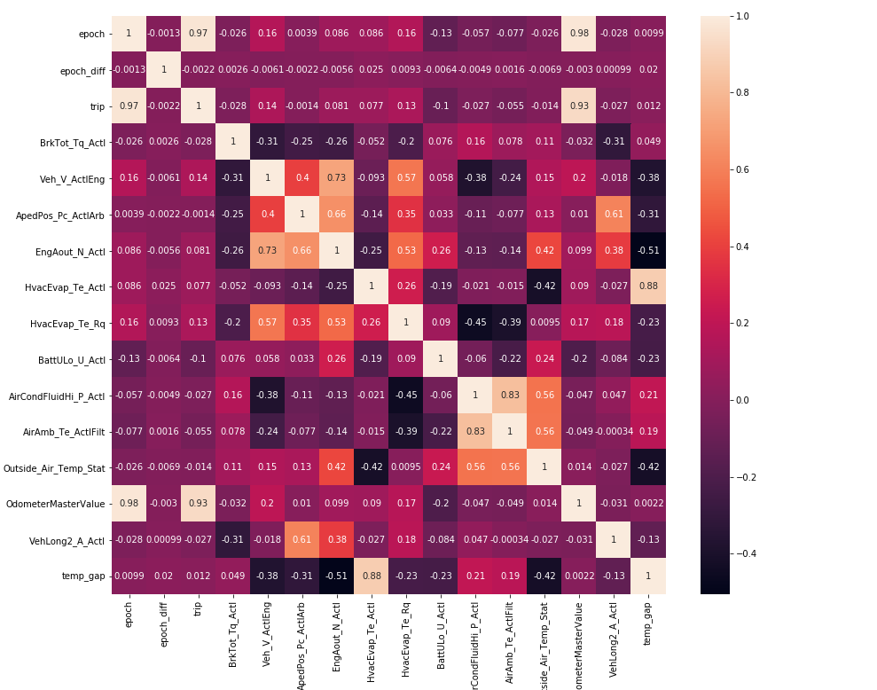
High-Level Statistics

Slide 8
Analysis: VIN #############1079
Our study is divided into two main analyses:
Analyzing the time intervals during which the actual temp. is below 0°C.
What is the duration that the internal temp. of the compressor is below 0°C?
How often is the internal temp. below 0°C?
Understanding how the difference in actual temp. and requested temp. changes through the span of data collection.

Slide 9
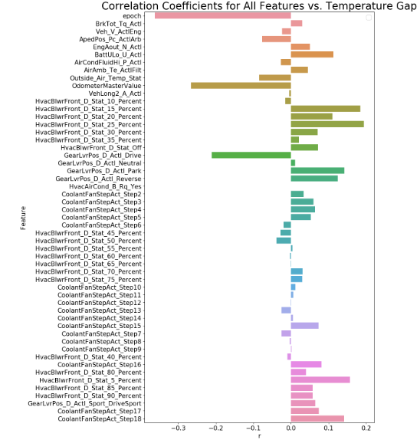
Understanding the Difference in Actual and Requested Temperature

Slide 10
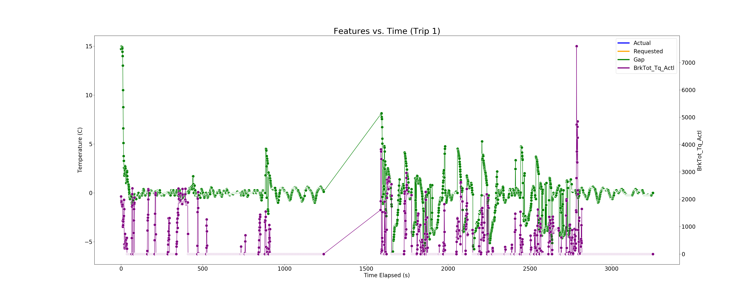
Understanding the Difference in Actual and Requested Temperature

Slide 11
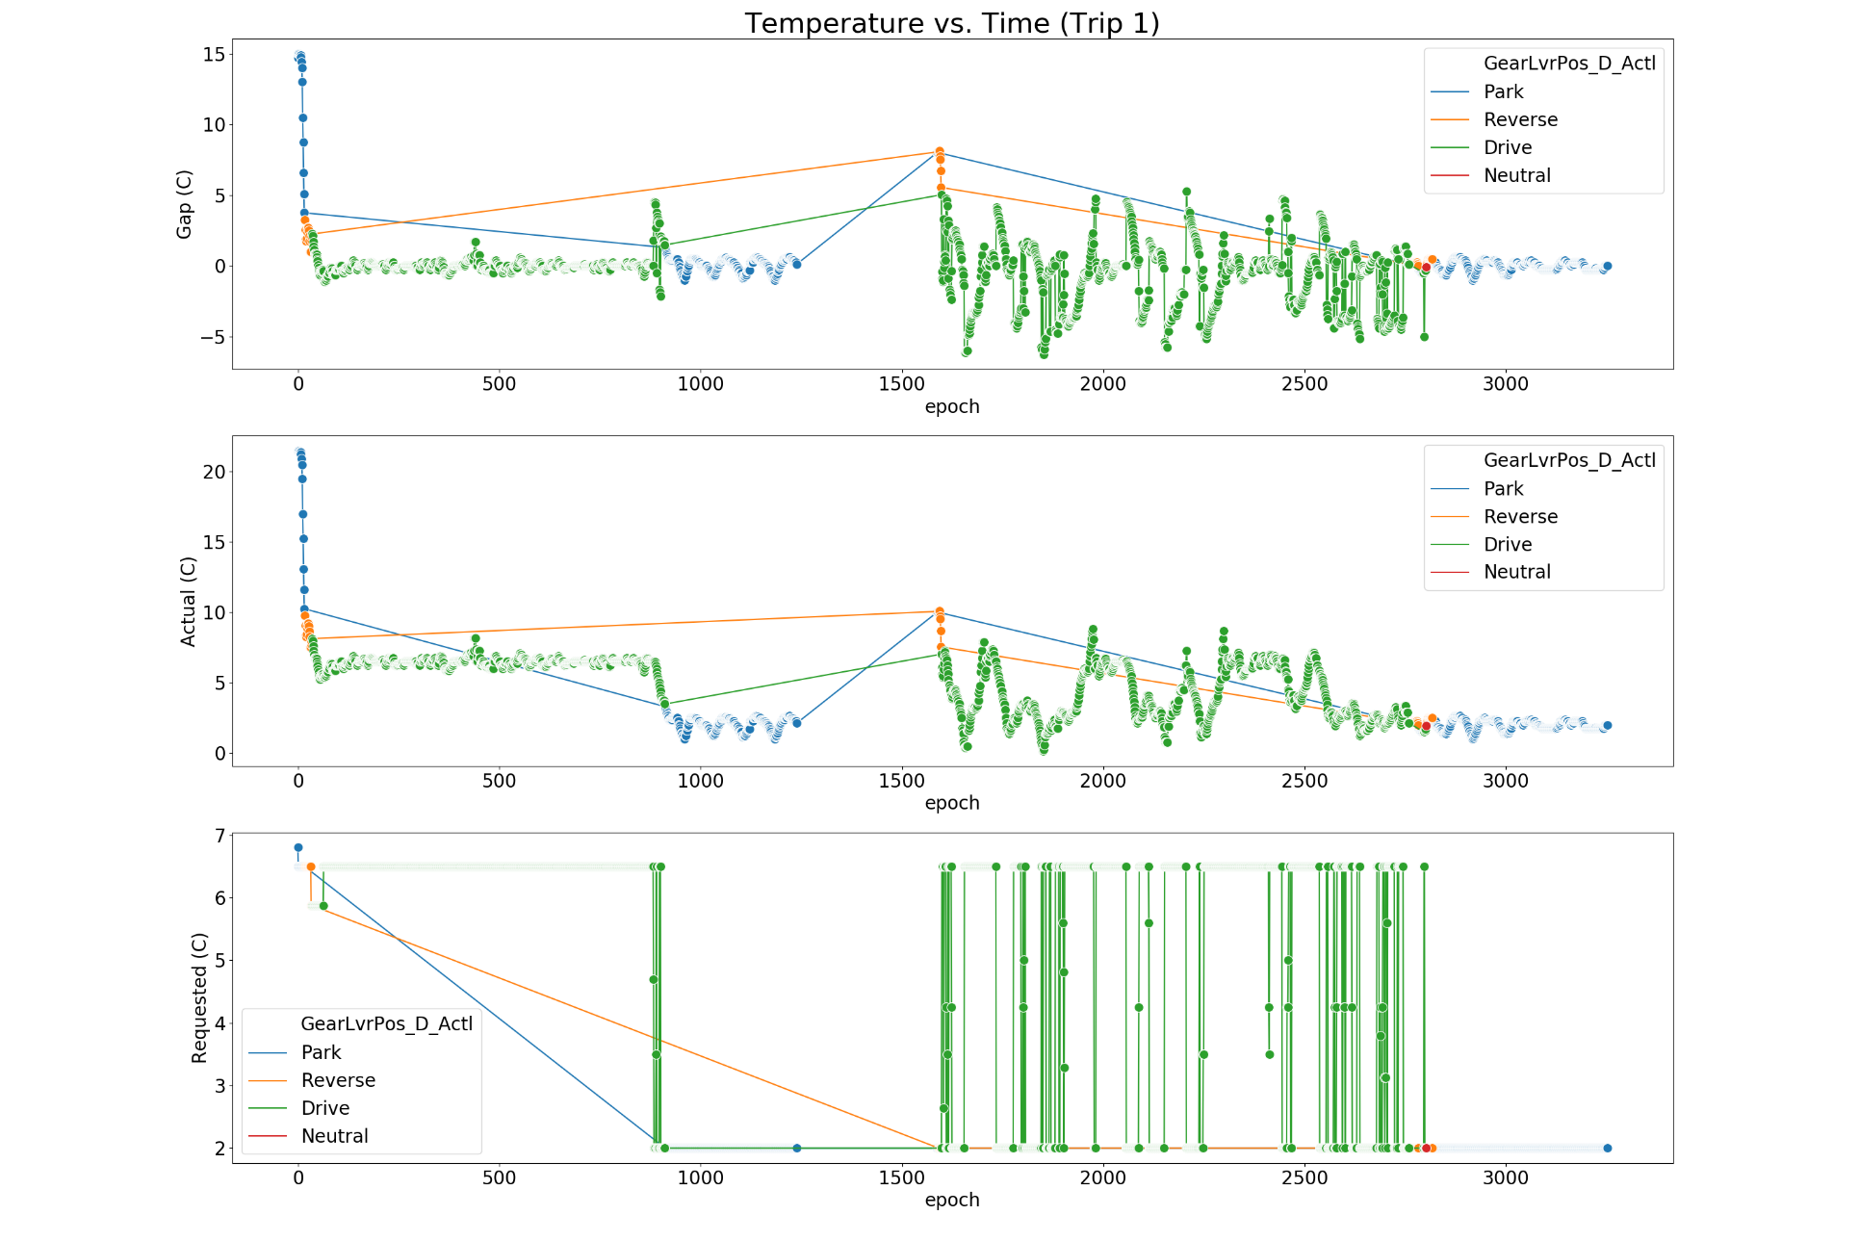
Understanding the Difference in Actual and Requested Temperature

Slide 12
Demo

Slide 13
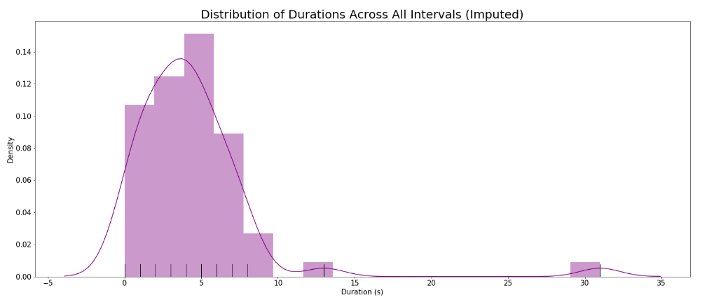
Analyzing Time Intervals With Negative Temperatures

Slide 14
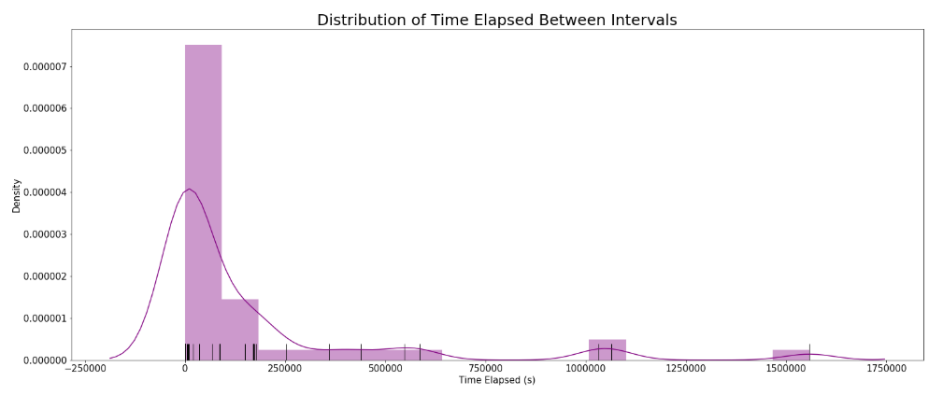
Analyzing Time Intervals With Negative Temperatures
Over the span of summer 2019 (May - July), the actual temperature is below 0°C every 161296 seconds (1.8 days) on average.

Slide 15
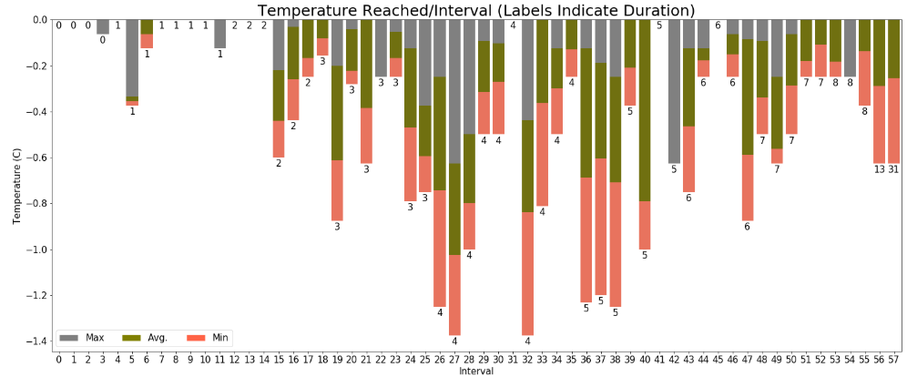
Analyzing Time Intervals With Negative Temperatures

Slide 16
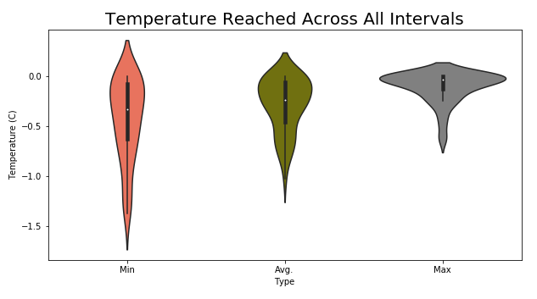
Analyzing Time Intervals With Negative Temperatures

Slide 17
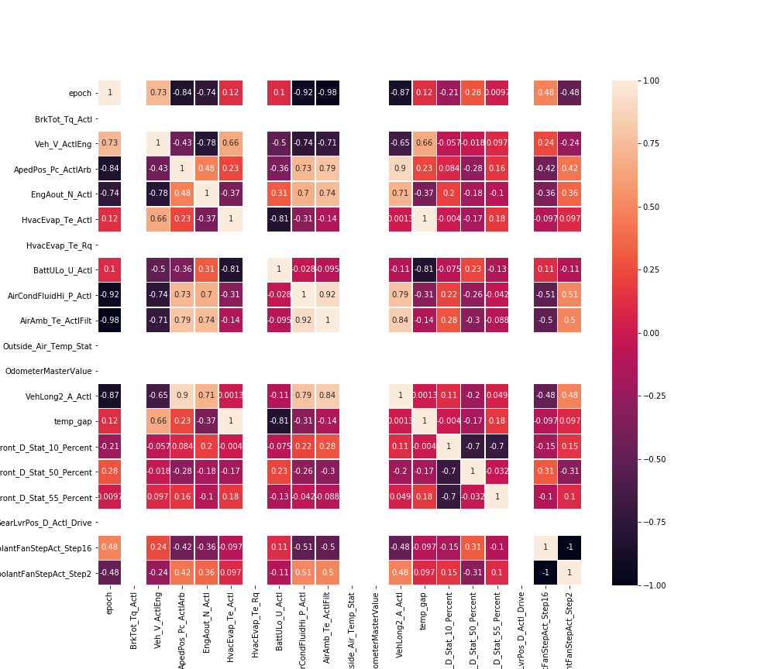
Analyzing Time Intervals With Negative Temperatures
Interval 57 looks particularly concerning, as it lasts the longest (31 seconds) and reaches a minimum temperature of -0.6.

Slide 18
Demo

Slide 19
What’s Next?
We wanted to seek your advice to determine moving forward and whether any of these correlations provide insight to your team.
Perform rudimentary analysis on Explorer.
Identify selection criteria for F-150s.
Determine CAN signals of interest.
Collect data for F-150s.
Conduct analysis.
Scale study to other vehicle types.

Slide 20
Appendix

Slide 21
Notebooks w/ Analysis: https://github.ford.com/MFARD/BDD-Climate-Control

Slide 22
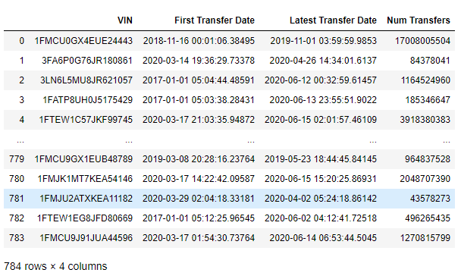
F-150 Selection
Extract all 784 F-150 VINs from BDD.

Slide 23
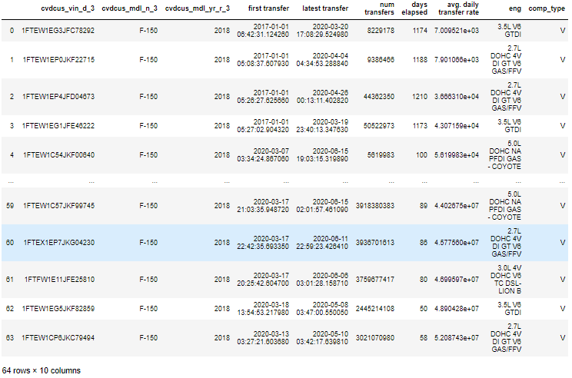
F-150 Selection
64 2018 F-150s subset based on selection criteria.

Slide 24
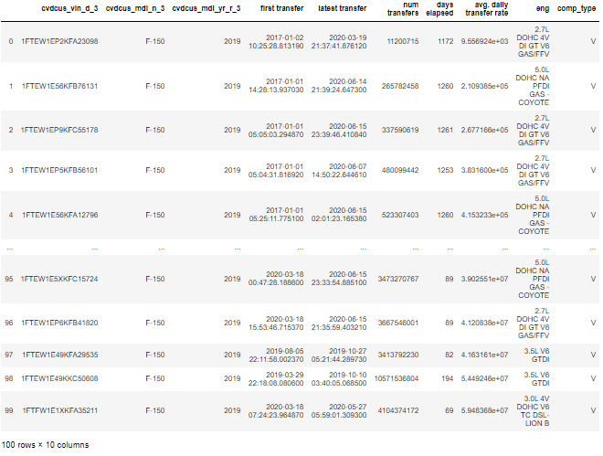
F-150 Selection
100 2019 F-150s subset based on selection criteria.

Slide 25
Additional Visuals

Slide 26
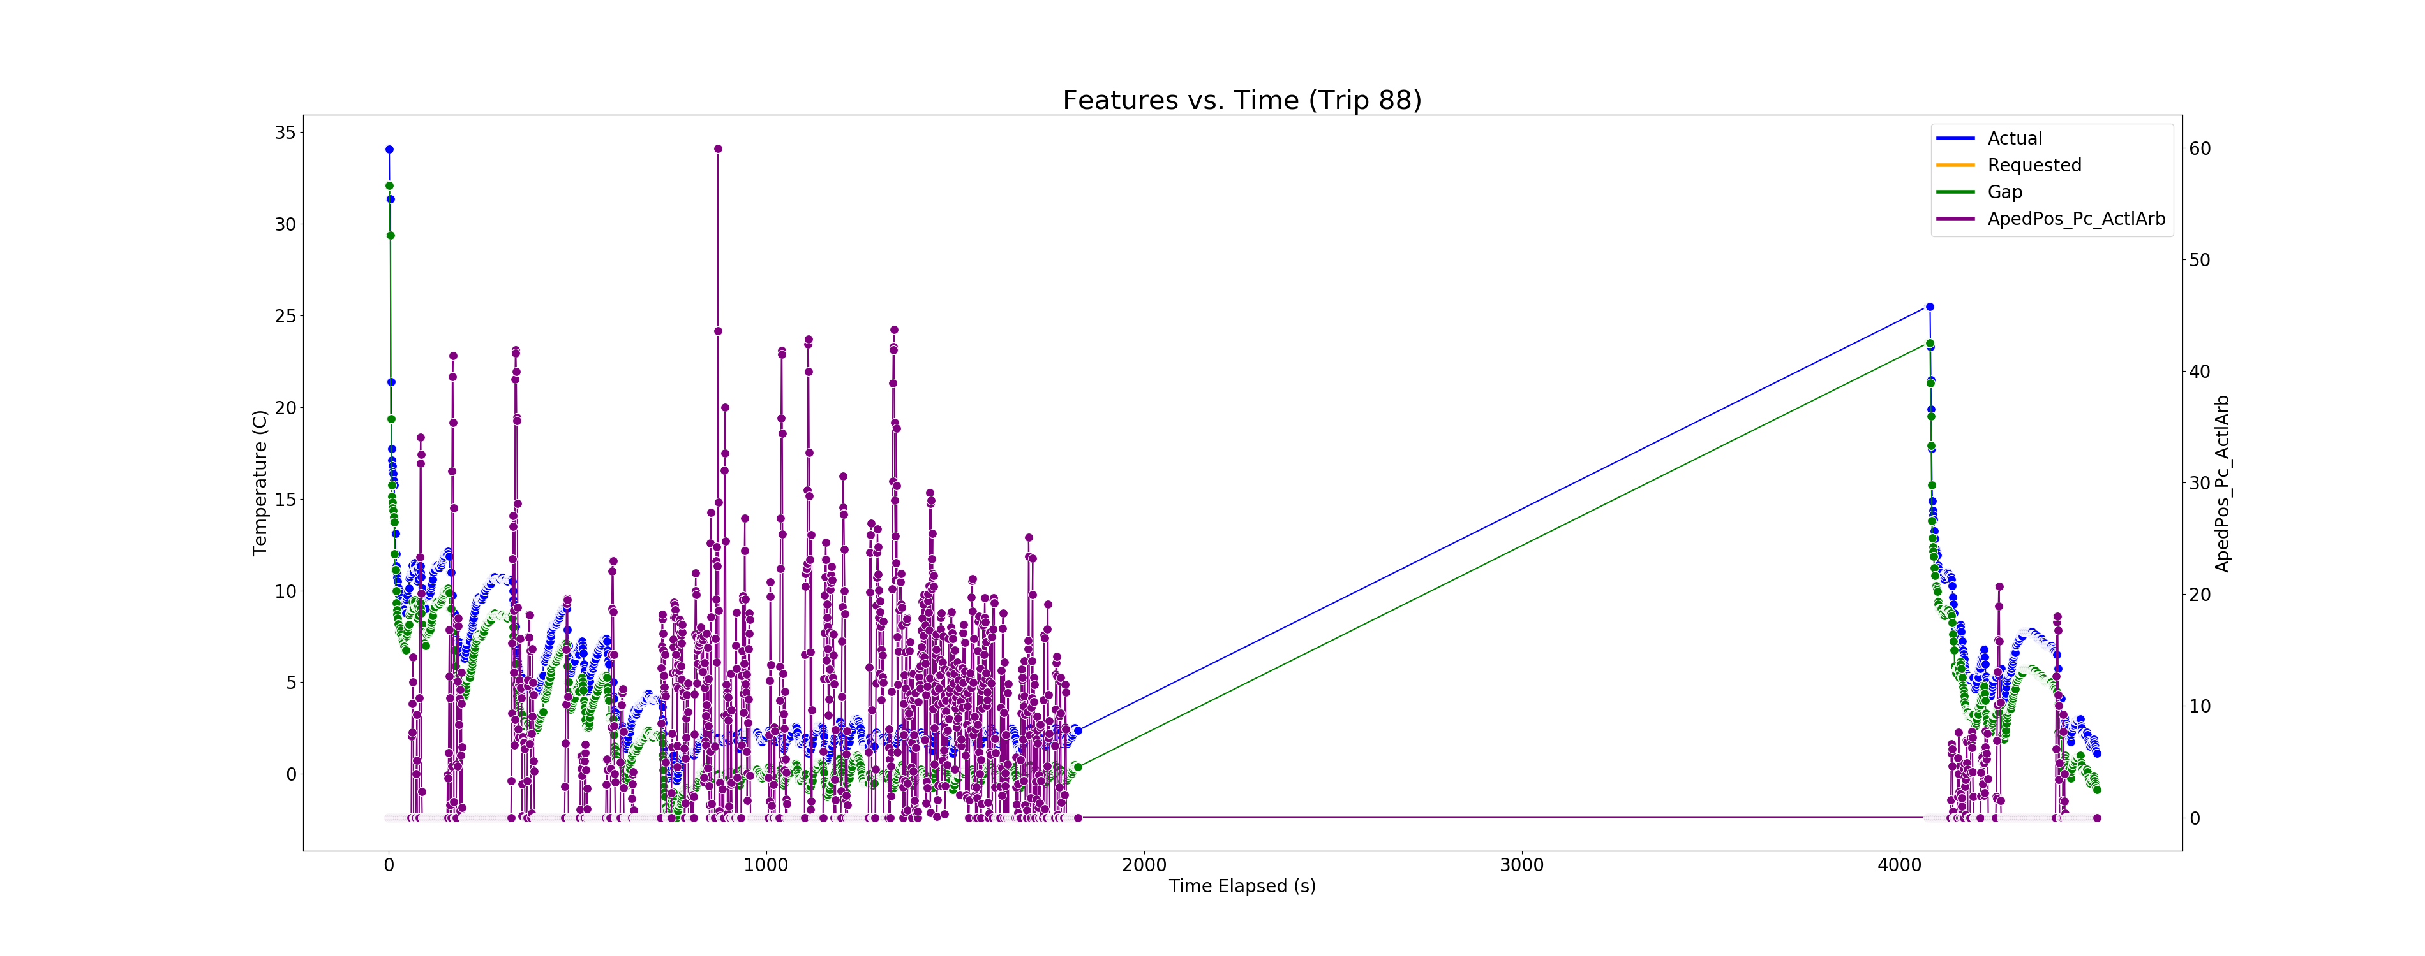
Trip 88
Increase in actual temperature when pedal position = 0.

Slide 27
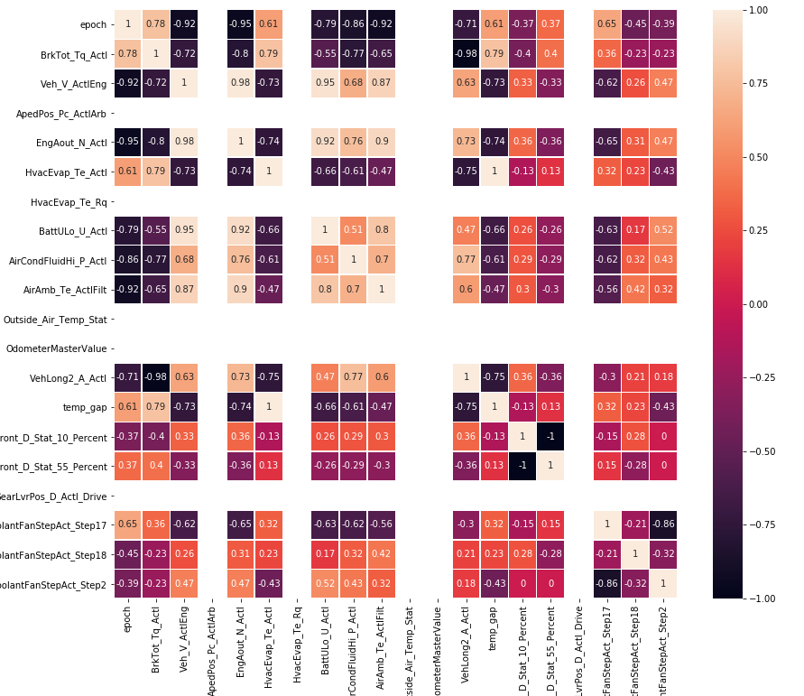
Correlations Between Features for Negative Temperature Intervals (Trips 76 & 79)

Slide 28
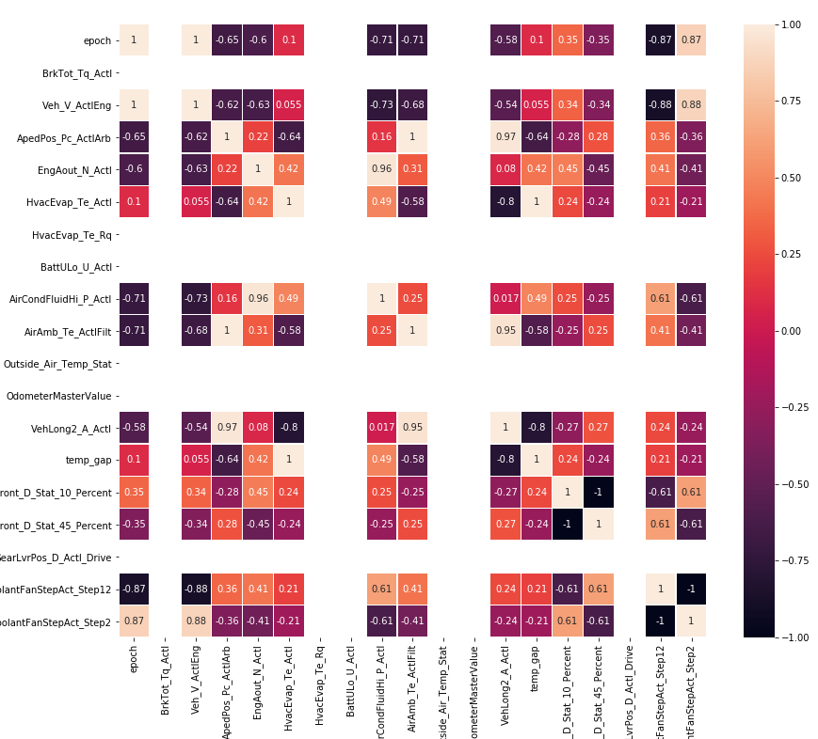
Correlations Between Features for Negative Temperature Intervals (Trip 92)

